Slide 1
Hadoop Basics
Hadoop Ecosystem

Slide 2
Classification
HMS – Vitreos Internal
* If you are the intended recipient of the presentation, please delete the copy of presentation with you and inform concerned person at HMS

Slide 3
PreRequisites
Shell
SQL
Basic understanding of Master-Slave Configuration(Not Mandatory)

Slide 4
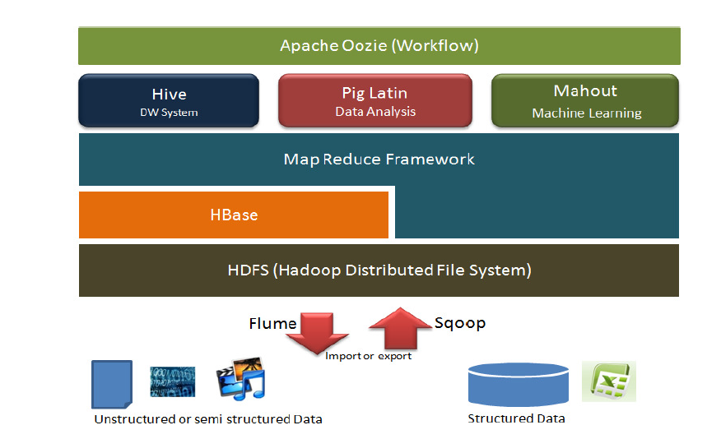
Hadoop Ecosystem Architecture

Slide 5
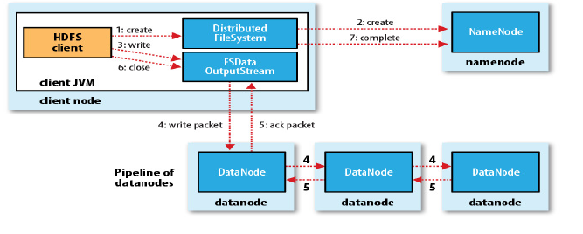
HDFS - Hadoop Distributed File System
Files are stored in HDFS and divided into blocks, which are then copied to multiple Data Nodes
Hadoop cluster contains only one NameNode and many DataNodes
Data blocks are replicated for High Availability and fast access

Slide 6
HDFS - NameNode
NameNode
Run on a separate machine.
Manage the le system namespace, and control access of external clients
Store le system Meta-data in memory
File information, each block information of files, and every fileblock information in Data Node

Slide 7
HDFS - Datanode
Run on Separate machine,which is the basic unit of file storage.
Sent all messages of existing Blocks periodically to Name Node.
Data Node response read and write request from the Name
Node, and also respond, create, delete, and copy the block command from Name Node.

Slide 8
Map Reduce
Files are split into xed sized blocks and stored on data
nodes (Default 64MB)
Programs written, can process on distributed clusters in
parallel.
Input data is a set of key/value pairs, the output is also
the key/value pairs.
Mainly Two Phase Map and Reduce.

Slide 9
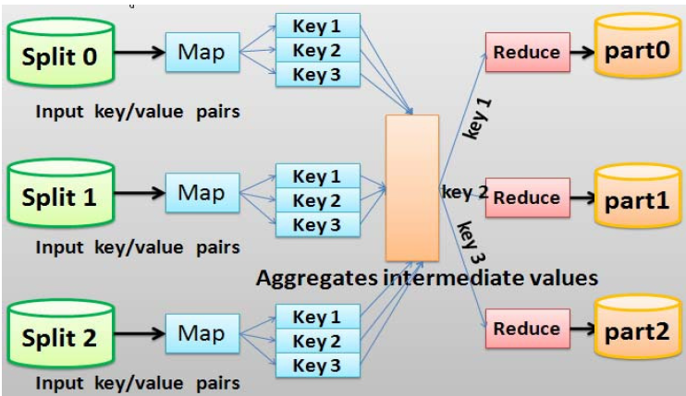
Map Reduce Example

Slide 10
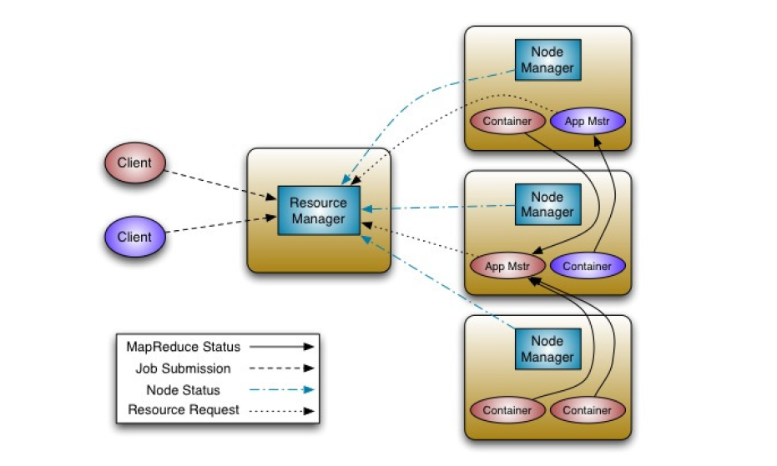
YARN (Yet Another Resource Negotiator)

Slide 11
Pig
Pig is a framework consisting of a high-level scripting language (Pig Latin).
Run-time environment that allows users to execute MapReduce on a Hadoop cluster.
Like HiveQL in Hive, Pig Latin is a higher-level language that compiles to MapReduce.
Pig is more flexible than Hive with respect to possible data format.
Pig's data model is similar to the relational data model, except that tuples (a.k.a. records or rows) can be nested.

Slide 12
Hive
Apache Hive is a data warehouse infrastructure built on top of Hadoop for providing data summarization, query and analysis.
Using Hadoop was not easy for end users those who were not familiar with MapReduce framework.
A Hive query is converted to MapReduce tasks.

Slide 13
Sqoop
Sqoop allows easy import and export of data from structured data stores
Command-line tool to import any JDBC supported database into Hadoop
Generate Writables for use in MapReduce jobs
High performance connectors for some RDBMS
Distributed, reliable, available service for efficiently moving large amount of data as it is produced.
Suited for gathering log from multiple systems Inserting them into HDFS as they are generated
Design Goal : Reliability , Scalability , Manageability, Extensibility

Slide 14
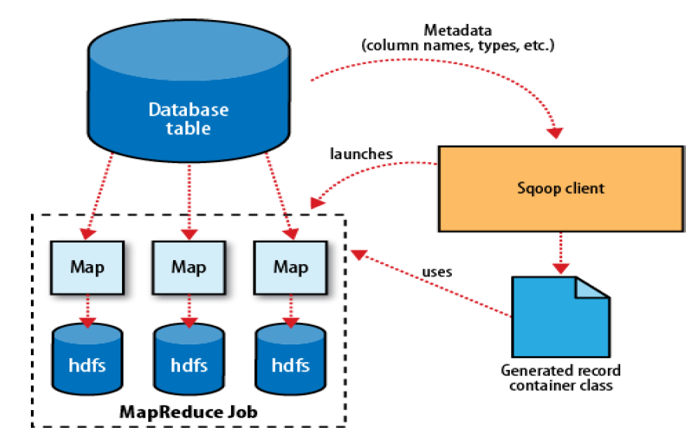
SQOOP (Cont)

Slide 15
Zookeeper
ZooKeeper is a distributed, open-source coordination service for distributed applications
They are especially prone to errors such as race conditions and deadlock
Generate Writables for use in MapReduce jobs
ZooKeeper is to relieve distributed applications the responsibility of implementing coordination services from scratch
ZooKeeper allows distributed processes to coordinate with each other through a shared hierarchical namespace.
The name space consists of data registers called znodes, and these are similar to files and directories
ZooKeeper data is kept in-memory, which means it can achieve high throughput and low latency numbers

Slide 16
Core Hadoop Configuration FIles
Configuration Files are the files which are located in the extracted tar.gz file in the etc/hadoop/ directory.
HADOOP-ENV.sh
It specifies the environment variables that affect the JDK used by Hadoop Daemon (bin/hadoop)
CORE-SITE.XML
It is one of the important configuration files which is required for runtime environment settings of a Hadoop cluster.It informs Hadoop daemons where the NAMENODE runs in the cluster. It also informs the Name Node as to which IP and ports it should bind.
HDFS-SITE.XML
It is one of the important configuration files which is required for runtime environment settings of a Hadoop. It contains the configuration settings for NAMENODE, DATANODE, SECONDARYNODE. It is used to specify default block replication. The actual number of replications can also be specified when the file is created

Slide 17
Core Hadoop Configuration FIles
4) MAPRED-SITE.XML
It is one of the important configuration files which is required for runtime environment settings of a Hadoop. It contains the configuration settings for MapReduce . In this file, we specify a framework name for MapReduce, by setting the MapReduce.framework.name (local, classic or yarn)
Follow the link to learn more about configuration files in Hadoop

Slide 18
Recap - Important Hidden Components and Processes
NameNode
Secondary NameNode
DataNode
JobTracker
Task Tracker

Slide 19
Basic Commands - HDFS
- hdfs dfs –copyFromLocal
- hdfs dfs –copyToLocal
- hdfs dfs –mv
- hdfs dfs –put
- hdfs dfs –get
- hdfs dfs –du
- hdfs dfs –ls
- hdfs dfs –cat
- hdfs dfs –df
-hdfs dfs –test –f/-d

Slide 20
Thank you

